Slide 1


Attrition Analytic Solutions – Healthcare
Notes:
Hello and Welcome! My name is Holly Figueroa and today I am going to be talking about data-based solutions for understanding and predicting healthcare worker attrition.

Slide 2
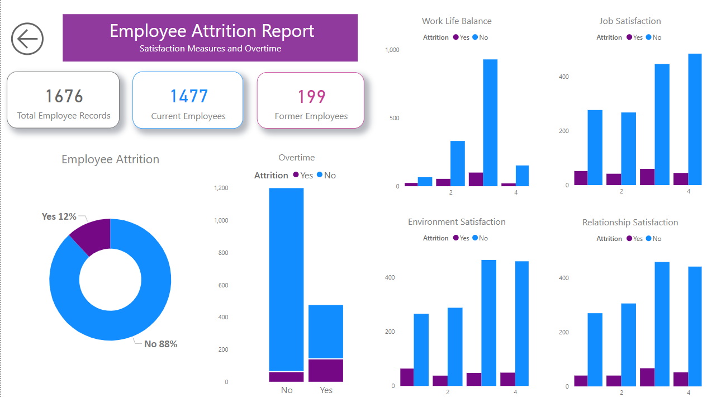
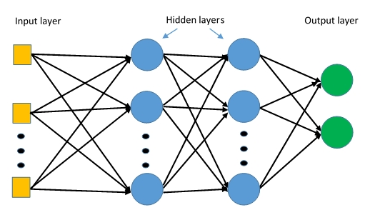
Research Questions
Deliverables
What does attrition look like given the data?
What factors influence attrition?
Can machine learning predict attrition?
What modeling approach works the best?
Notes:
To explore healthcare worker attrition a dataset was sourced from kaggle with the following research questions and targeted deliverables. First we wanted to see how many of all the employees left. Then we wanted to identify what factors appear to influence attrition. Finally, we wanted to build and test models to see if attrition can be predicted, and see which model performed best. The finalization of this project would then produce deliverables including a comprehensive dashboard of how attrition relates to employee attributes and a useable model to predict attrition.

Slide 3
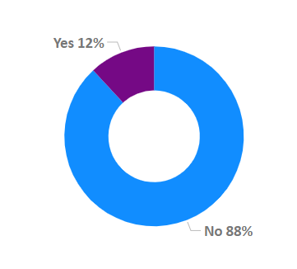
Dataset Details
Labeled dataset contained over 16k rows and 34 columns
Numeric and categorical data types
No missing values
Only 199 cases of attrition
Target Class – Employee Attrition
Notes:
So the dataset chosen was labeled, meaning each employee had a record of if they stayed or left the company and this variable was the target of analysis. The dataset contained over 16k rows and 34 columns of employee data, such as education, years with company, department, pay and measures of satisfaction. So with that the first thing to look at is out target and immediately it was found that it was imbalanced. This is a great thing from the perspective of an organization. You WANT low attrition of employees, BUT for analysis this creates challenges because a model needs examples of each target class to learn from, both employees that stay AND those that leave. This would be less problematic if the entire sample was larger, but in this case 12% meant only 199 cases to train AND test a model.

Slide 4
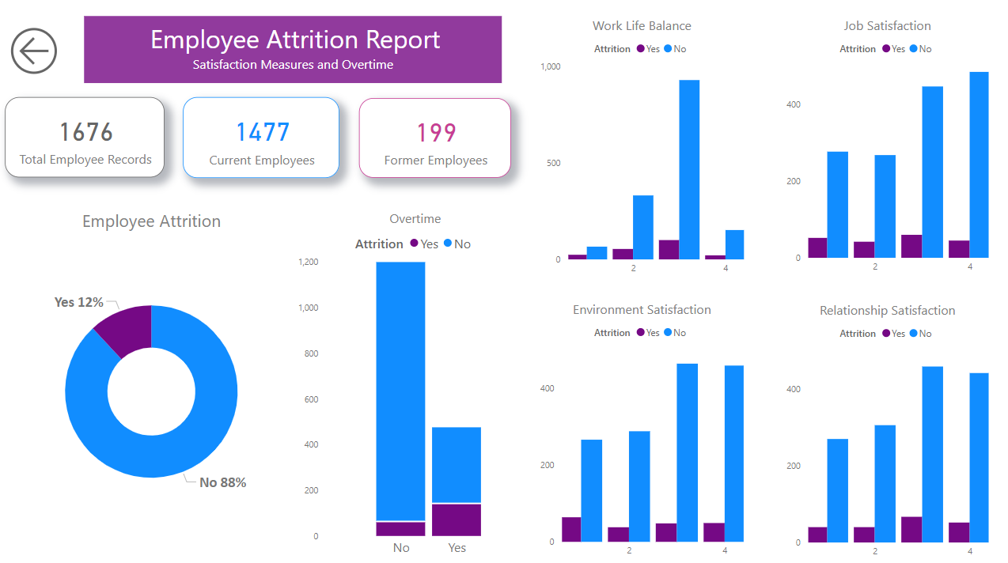
Notes:
Here is a look at some of the dashboard created to visually examine relationships between attrition and the rest of the available data. Some of these variables appear to have no relationship to attrition. But even at a glance we can see that employees that worked overtime had a higher proportion of employees that left. Another pattern that sticks out at a glance is Environment Satisfaction. We see that employees that stay are negatively skewed in satisfaction - the majority of them are happy but for the highest count of employees that left had 0 zero environment satisfaction.

Slide 5
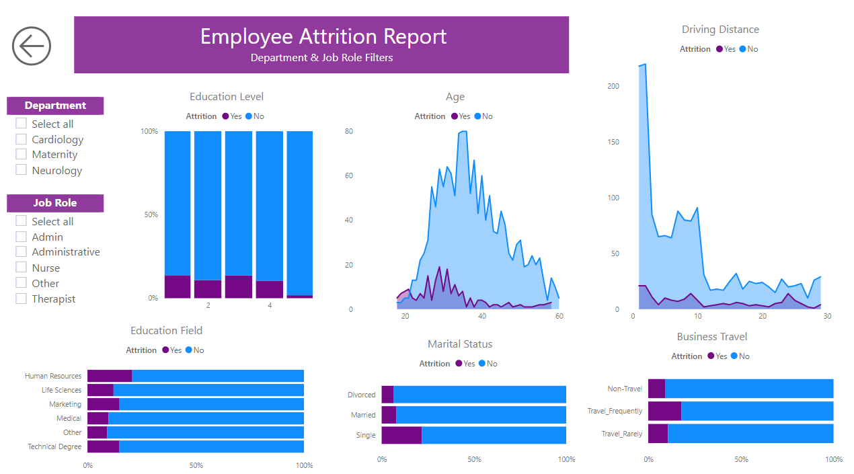
Notes:
This second page was created to allow the viewer to explore not only how attrition relates to different categories, but how that relationship looks across different job roles and departments. These bar charts are a unique choice in that they ignore counting how many employees fall into each category, and instead, focus on the percentage of attrition within each category. At a glance, I can see that human resources department actually has the highest proportion of attrition. Similarly, single employees, and employees that travel frequently in their position had higher percentages of attrition. Meanwhile the area charts show that employees who leave are a bit younger on average and employees who stay tend to drive less than 5 miles to work.

Slide 6
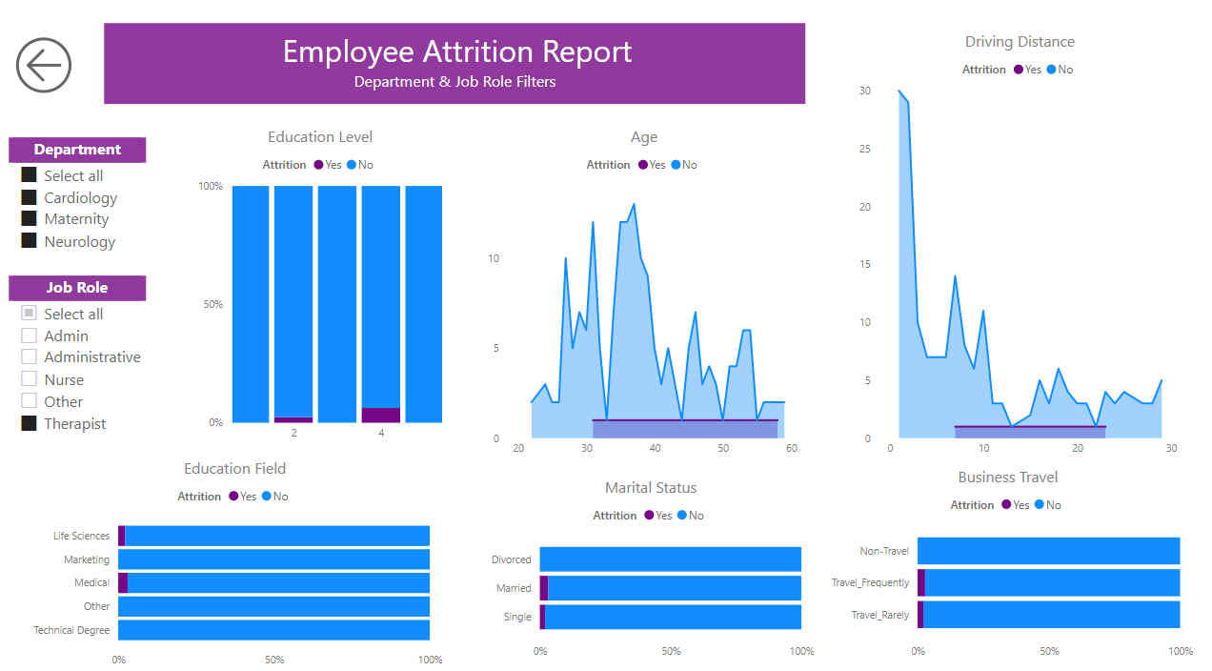
Notes:
When this same dashboard is filtered to therapist roles only, we see a very different story. First we can tell there is a lot less attrition in this role overall. And People in this role who leave are actually older on average, slightly more* likely to travel frequently, and slightly more likely to be married. The major take away from this is that attrition in complex, and a good model will be complex enough adjust to these differences.

Slide 7
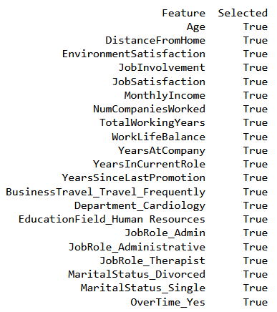
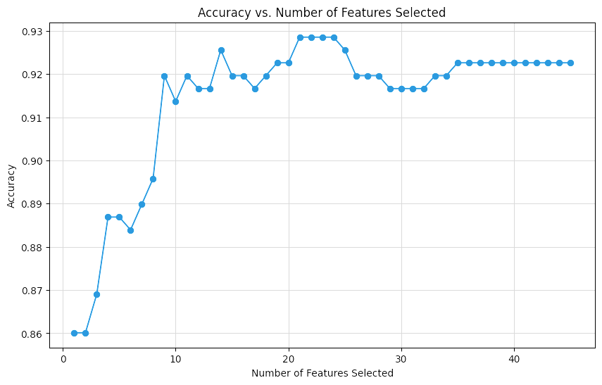
Recursive Feature Elimination (RFE)
Notes:
So prepare for modeling categorical variables had to be encoded and because this was required of many of the variables recursive feature elimination (or RFE) was used to pick out the more effective variables for predicting employee attrition. This would not only simply computation for any model, it would also return a list of variables that were best to consider for prescriptive action in regards to attrition. There was no pre-selected number of features desired. Instead here logistic regression was performed multiple times over different amounts of variables to identify the optimal number of features to include. The results are visualized here, and show clearly that 21 features performed best which are listed.

Slide 8
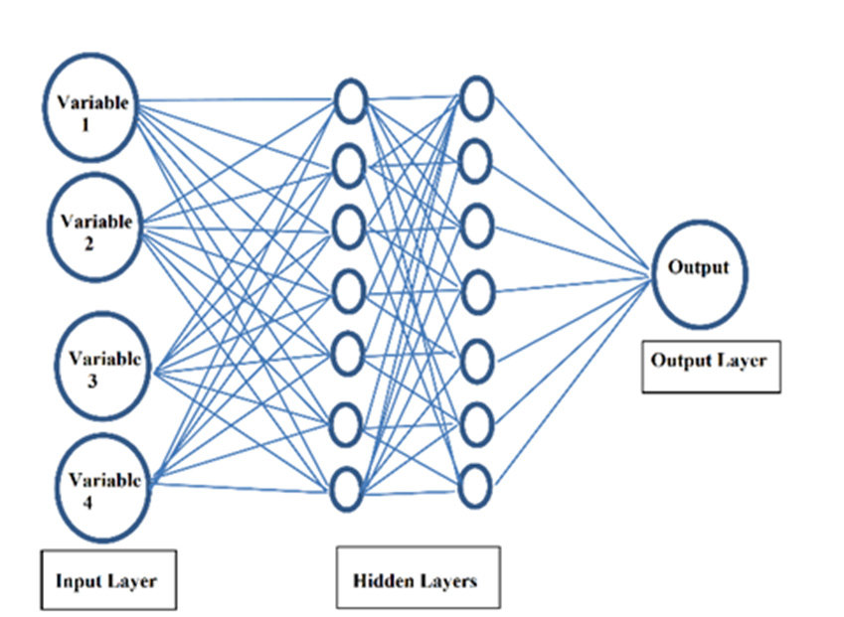

Prediction Models
Decision Tree Classifier
Model explainability
Versatile
Handles imbalanced data
Gradient Boosted Classifier
Robust against over-fitting
Handles imbalanced data
Learns from mistakes
Multi-layer Perceptron Classifier
Handles complex/non-linear relationships
Uses backpropagation to reduce error
Generates predictions quickly, once trained
Notes:
The first model chosen for training was a decision tree classifier….. The next was a gradient boosted classifier. Finally modeling was tried with a multilayer perceptron classifier.

Slide 9
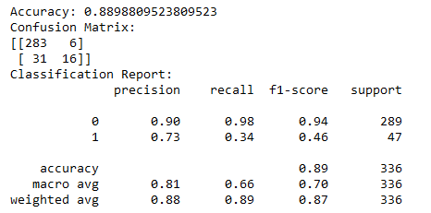
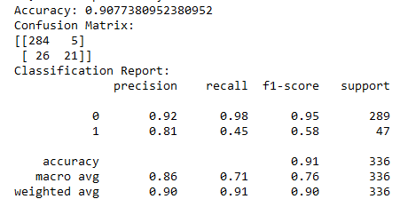
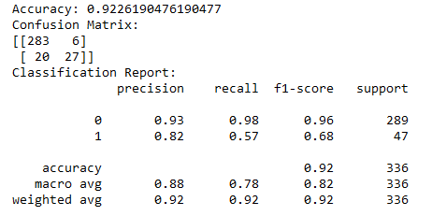
Comparing Results
Null Accuracy = 87%
Decision Tree Classifier
89%
Gradient Boosted Classifier
91%
Multi-layer Perceptron Classifier
92%
Notes:
To evaluate model performance null accuracy was calculated to offer a baseline to beat, as it represent the accuracy if you simply predict the most common class. With an imbalance in the data, it is not surprising this accuracy is actually rather high at 87%. With that in mind the first model only modestly out-performed this at 89%. The gradient boosted model seemed a good next step to focus on learning mistakes, but again, performance only nudged above the decision tree. Finally the MLP model was run with another modest bump in performance to 92%. While these scores appear to have minimal difference, the performance in predicting the target class was massively improved. Remember the null accuracy reflects guessing the majority class, in this case guessing that person did not leave the company. Therefore, it would missing every single case of attrition. The first model guessed 75% of attrition employees correctly, while the gradient boosted model got 81%. The MLP made it to 82% accuracy when guessing cases of attrition so it certainly out performed null accuracy, and did better than all other models.

Slide 10

Final Take-Aways
Your staff often holds the answers improving retention and attrition
Dashboards will allow for real-time insights and proactive responses
MLP modeling predicts attrition well and it will only perform better with additional training data
Notes:
With this final MLP model in hand, insights can continue to grow and evolve as more employee data is gained. As events occur and change rates of attrition the business will be better equipped to respond and evaluate fitness for hire. With a maintained dashboard, hr departments can continue to see trends reflected across groups, departments, roles, and over time. Finally, as the data pool build, modeling will likely improve its accuracy as more examples of attrition can be added in the retraining process.

